Slide 1
Python for beginners
Shuba Iyer and Shriya Kurpad

Slide 2
About us
Shuba Iyer - Pronounced “Shoe-ba Eye-er”
You can call me Ms. Iyer or Ms. Shuba
Shriya

Slide 3
What is programming
A problem to solve
A solution to the problem
The solution translated into a language the computer can understand

Slide 4
Ready to Learn Python?
Welcome!
Python is an easy to learn programming language.
You can use it to create web apps, games, even a search engine!

Slide 5
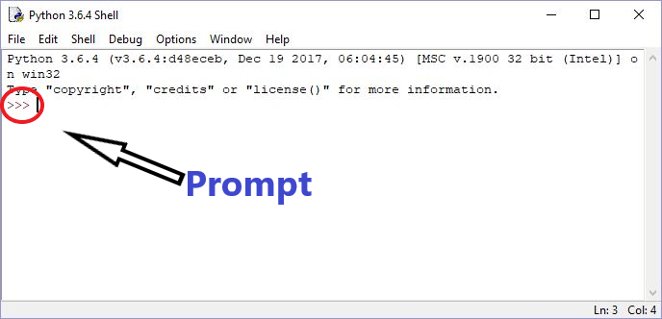
Python Integrated Development and Learning Environment (IDLE)

Slide 6
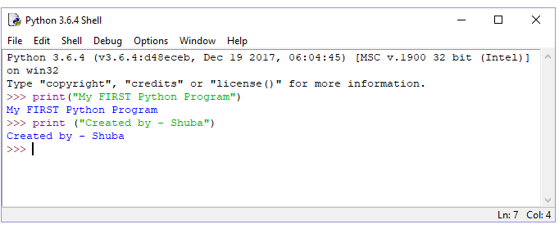
Your very first Python Program

Slide 7
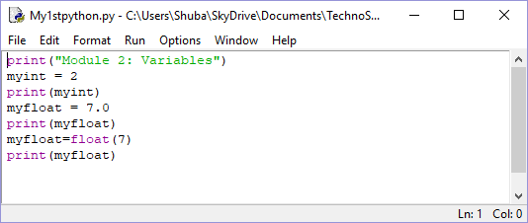
Simple Python script
Each line is a Python statement
In the shell window, type each statement and hit enter
Don’t forget the parentheses for the “print” statement
See what happens if you do not use parentheses

Slide 8
On your own-----
More operators:
divide: /
multiply: *
Try doing some math at the prompt:
>>> 6 * 5
>>> 6 / 2
>>> 10 * 5 * 3
Try doing some math at the prompt:
>>> 1 + 2
>>> 12 - 3
>>> 9 + 5 - 15
Operators:
add: +
subtract: -

Slide 9
Recap
What is Python?
Interpretive language
Also referred to as Scripting language
Python IDLE
Development environment
Also referred to as Shell
First Python program

